Slide 1
Flipped classroom
Digital tools

Slide 2
Plan
Figure out which lesson in particular you want to flip. Outline the key learning outcomes and a lesson plan.
Record
Instead of teaching this lesson in-person, make a video, select the text or any other resources. A screencast works. Make sure it contains all the key elements you’d mention in the classroom.
Share
Send it to your students. Make it engaging and clear. Explain that the content will be fully discussed in class. Ask your students to make notes \ask questions

Slide 3
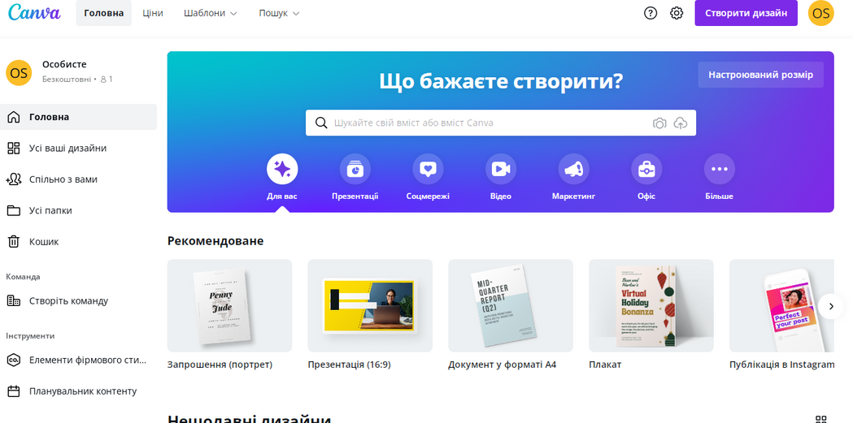
creating presentations, infografics
or videos for students
collaboration\ group projects

Slide 4
Students watch videos or work with some vocabulary or grammmar at home,
Then you start by checking whether they understood the concept or language introduced

Slide 5
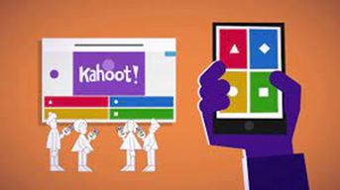
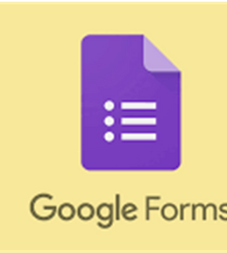
creating educational videos
posting tasks\ asking questions\ making notes\ promoting discussion
concept checking questions\
checking comprehension\
sharing opinions

Slide 6
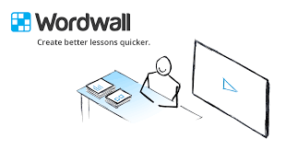
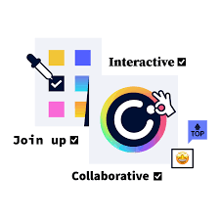
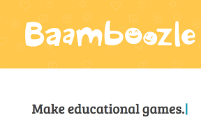
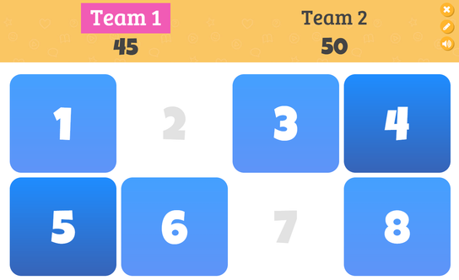

Slide 7
Dangerous definitions

Slide 8
lollygag
bamboozle
part os speech/ meaning
???
phubbing
shenanigans

Slide 9
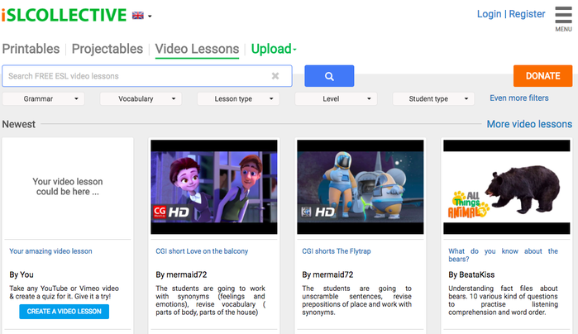
Edpuzzle is usually called a tool for a flipped classroom
This free service allows to create educational videos with
build-in questions, quizes or comments. Any YouTube video can be easily turned into a real video lesson to boost interaction and thinking and offering feedback

Slide 10
Active learning.
In-class activities that engage students in discussion, production time when your students can use new language and share ideas
Peer instruction.
Students can teach each other by explaining concepts or working on small problems.
Collaborative learning\Learning stations
Collaborative learning activities could increase student engagement, enhance student understanding, and promote collective intelligence.
Discussions or debate.
Give students the opportunity to articulate their thoughts on the spot and to develop their arguments in support of their opinions or claims.

Slide 11
Padlet can be used by students and by teachers. With padlet you can create an online post-it board that you can share with any student you want
Just give them the unique Padlet link.
It’s easy to use and very handy.
Whoever has the Padlet board opened on his smartphone or computer, can see what’s on it and what everyone is writing.
You can install the Padlet app on your phone or just go to the Padlet website.

Slide 12
Delayed error correction
Brainstorming on a topic, statement, project or idea
Presenting projects and peer correction
Tops and tips
Discussion
Live question bank
Online student portfolio
Exit Ticket Padlet

Slide 14
Try it and you migh find new ways
to apply it in your classroom

Slide 15
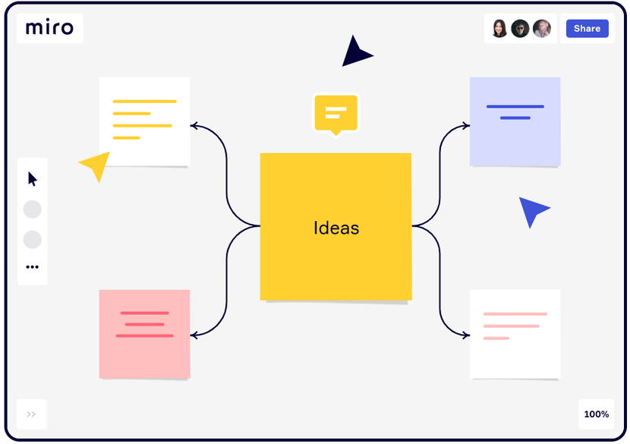
Miro is the online whiteboard for team collaboration
Great for preparing
a flipped lesson

Slide 16
S
SPECIFIC
You should know the outcome of your goal
M
MEASURABLE
You should know when you will have reached your goal
A
ACHIEVABLE
You should be able to achieve your goals
R
RELEVANT
Will your goal help you in the long run?
T
TIME-BOUND
Set a time frame for your goals

Slide 17
thank you!

